Slide 1
Introduction to RS485
A Brief Overview of RS-485 Communication Protocol
It was created for improvement of RS-232
It was created by the Telecommunications Industry Association and Electronic Industries Alliance (TIA/EIA)
It is also referred as RS-485, TIA/EIA-485, TIA - 485
It works as a Master slave module protocol

Slide 2
Advantage of RS-485
Allows reliable serial communication on a 2-wire network
Distance up to 1200m
Data rate up to 10Mbps
Up to 32-line device
Allow good communication in Noisy Environment
Worked in Half duplex mode but can work Full duplex mode also(with 4 Pin)

Slide 3
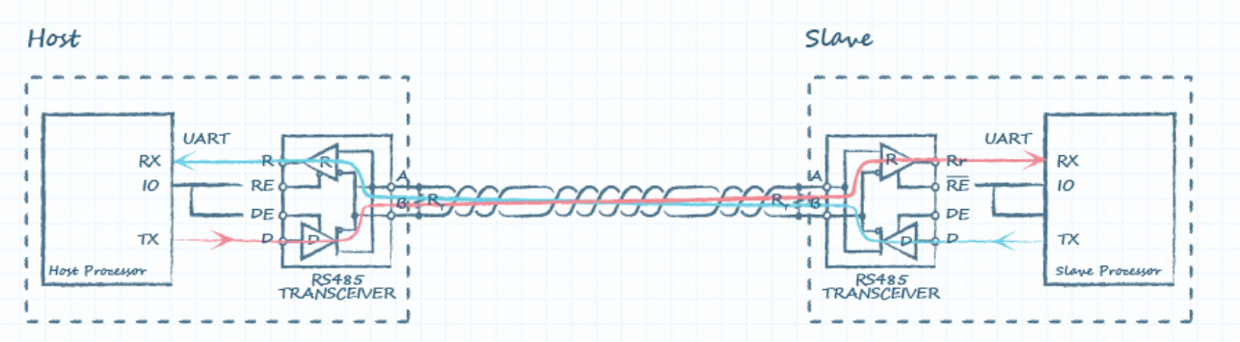
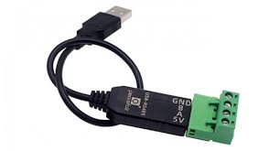
Communication Diagram
USB to RS485 Converter in the R414A01 Module

Slide 4
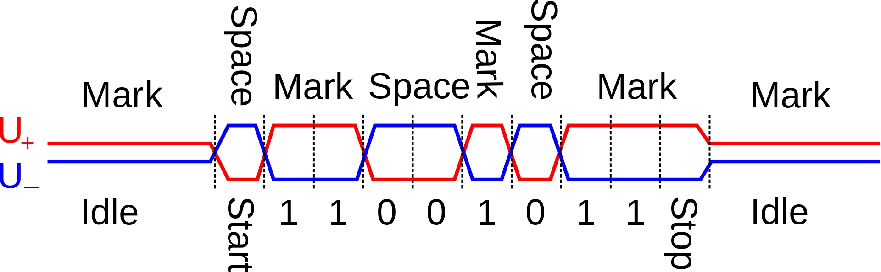
Signal Transmission

Slide 5
